Slide 1


ACME A powerful ADL
Project 2
OP5
ADL presentation
Euro Team
Alauzet Pierre, Ahvenniemi Mikko,
Colin Julien, Starck Benoit
CS554 - Design for Software & Systems

Slide 2
Table of Contents
Why do we use ADLs ?
ADL investigation & choice
ACME presentation
ATAM introduction

Slide 3
1. Why do we use ADLS ?
Why do we use ADLs?
ADL Choice
ACME Presentation
ATAM introduction
Necessity of using standardized architectural representation
ADLs bring standards for architecture description, just as what
UML do for design
Entity-relationship model do for database
Using architectural styles for the structure
Pipe and filters
Client/Server
…
Using formal language
Components
Connectors
…
Makes the architecture universally understandable
Designers
Programmers
Stakeholders

Slide 4
1. Why do we use ADLS ?(cont.)
Why do we use ADLs?
ADL Choice
ACME Presentation
ATAM introduction
ADLs bring the tools for architecture evolution and reusability
Makes the architecture assessable using external tools or methods

Slide 5
2. ADL investigation and choice
Why do we use ADLs?
ADL Choice
ACME Presentation
ATAM introduction
Comparison between several available ADLs
Abacus
Rapide
Wright
ACME
Unicon
AADL

Slide 6
2. ADL investigation and choice
Why do we use ADLs?
ADL Choice
ACME Presentation
ATAM introduction
Comparison between several available ADLs
Abacus
Rapide
Wright
ACME
Unicon
AADL
→ Comparison with Wright

Slide 7
2. ADL investigation and choice (CONT.)
WRIGHT :

Slide 8
2. ADL investigation and choice (cont.)
Why do we use ADLs?
ADL Choice
ACME Presentation
ATAM introduction
We have chosen ACME !
Well known
A lot of documentation
Website
HTML large documentation
Tutorials available
Complete and well-made software as an Eclipse plug-in
Free software available on every platforms
Developed in the same university as ATAM method – Carneggie Melon University

Slide 9
3. What is acme ?
Why do we use ADLs?
ADL Choice
ACME Presentation
ATAM introduction
Acme created in 1995 by Carnegie Mellon University
The original goal was to provide a common language that could be used to support the interchange of architectural descriptions between a variety of architectural design tools.
Provide a generic, extensible infrastructure for describing, representing, generating, and analyzing software architecture language description.
Provide descriptions that are easy to understand for everyone

Slide 10
3. Acme kernel & elements
Why do we use ADLs?
ADL Choice
ACME Presentation
ATAM introduction
Components, with ports
Connectors, with roles
Attachments of particular ports to particular roles
Properties of any of above

Slide 11
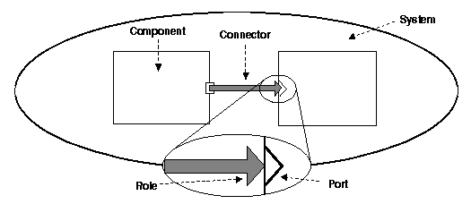
3. Acme description
Why do we use ADLs?
ADL Choice
ACME Presentation
ATAM introduction
ACME describes a whole system thanks to
Library of 7 architectural elements
Components
connectors
systems
ports
Roles
representations
representation maps
Architectural families
Tiered
Pipe & filters
Client & servers
Pub-Sub
Shared data
Three-tiered

Slide 12
3. Acme description
Why do we use ADLs?
ADL Choice
ACME Presentation
ATAM introduction
Component
Primary computational elements & data stores
Filter
Object
Client/Server
Database
Black board
Connectors
Interaction among components
Communication & coordination among components
Component
Connector

Slide 13
3. ACME Description (cont.)
Why do we use ADLs?
ADL Choice
ACME Presentation
ATAM introduction
Systems
Configuration of components & connectors
Role
Particularity of the connector
Describes how the connector links the components
Ex : client-server connector has 2 roles designated caller & callee
Port
Anchorage point on the component
Describes input or ouptut of a component
Can be unique or multiple
System
Component
Connector
Component
Role
Connector
Component
Port

Slide 14
3. ACME particularities
Why do we use ADLs?
ADL Choice
ACME Presentation
ATAM introduction
Representation
Lower level view of a component
Component contains & represents a sub system
Way to abstract complex system
System
Component
Connector
Component
Component

Slide 15
3. ACME particularities (cont.)
Why do we use ADLs?
ADL Choice
ACME Presentation
ATAM introduction
ACME method allows a translation mechanism…
… using properties
Runtime semantics
Data type for communication between components
Protocols of interaction
… allowing other tools to interpret the architecture
ADL's (Wright, Unicon, etc.)
…
Type structuring allows the architect to create templates to be
Used within a project : from one client/one server to multiple clients/multiple servers architecture
Reused in other projects involving the same kind of structure

Slide 16
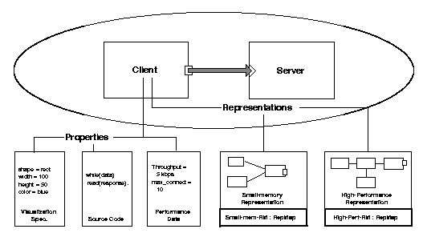
3. ACME particularities (cont.)
Why do we use ADLs?
ADL Choice
ACME Presentation
ATAM introduction
Illustration of representation and properties of a component

Slide 17
3. Acme language
Why do we use ADLs?
ADL Choice
ACME Presentation
ATAM introduction
Language is based on
First order predicate logic
Rules checking if architectural model is well formed
Rules can be defined
By the style designer
By ourself
2 types of rules
Invariant : violations of which are errors
Heuristics : violations of which leads to warnings

Slide 18
3. Acme tool
Why do we use ADLs?
ADL Choice
ACME Presentation
ATAM introduction
Eclipse plug-in software : AcmeStudio
AcmeStudio
Graphical interface
Architecture drawing
Design analyze
Language description (development)
Features
Create or edit families
Edit visualization
Edit and check rules
Edit properties
Etc…

Slide 19
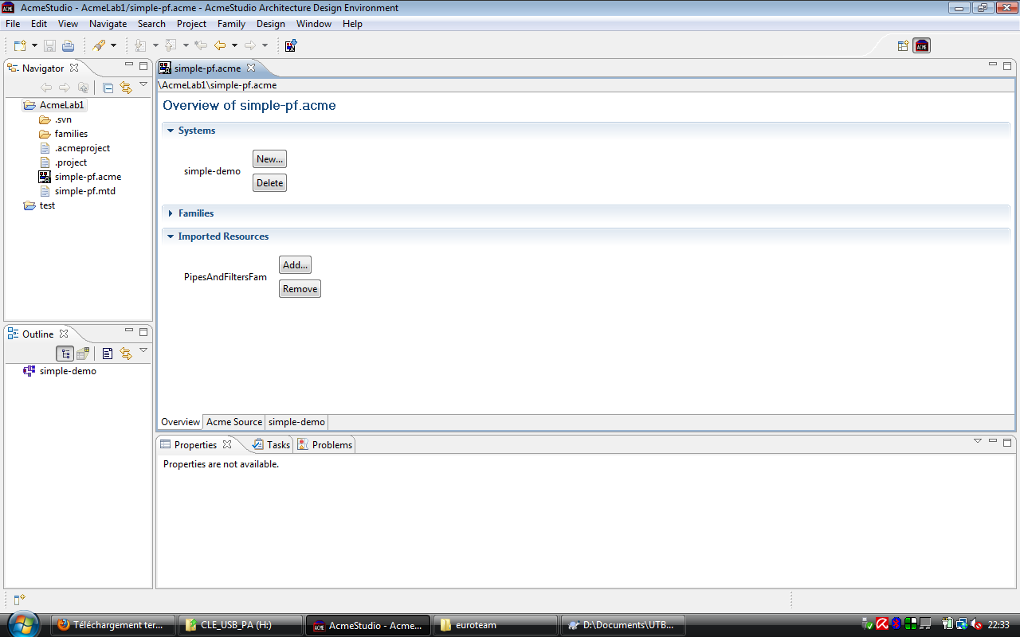
3. ACMESTUDIO
Why do we use ADLs?
ADL Choice
ACME Presentation
ATAM introduction

Slide 20
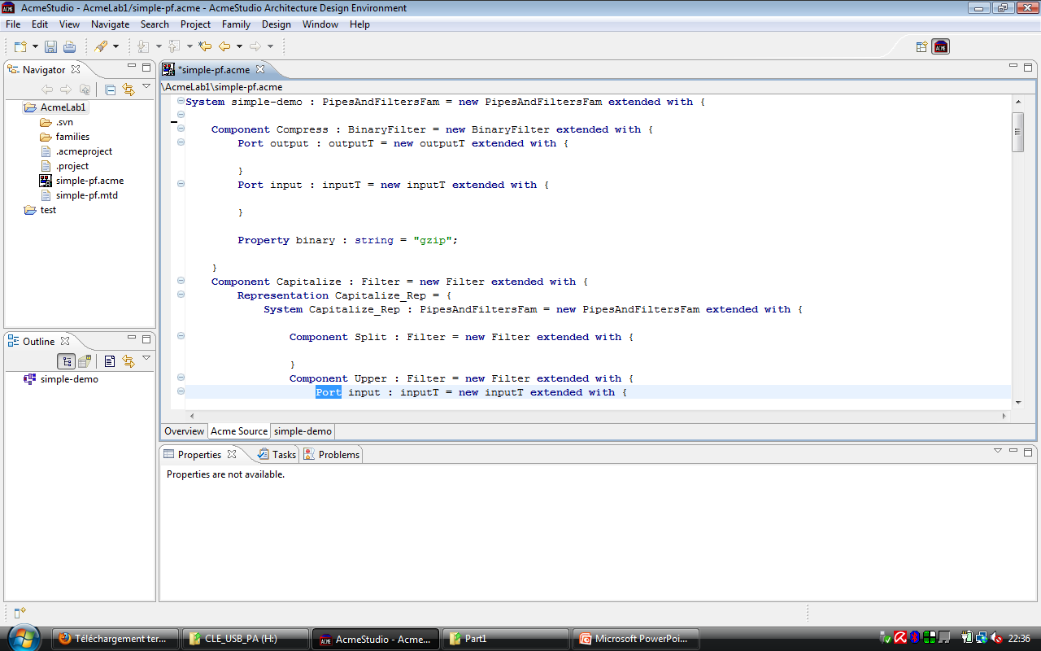
3. ACMESTUDIO (cont.)
Why do we use ADLs?
ADL Choice
ACME Presentation
ATAM introduction

Slide 21
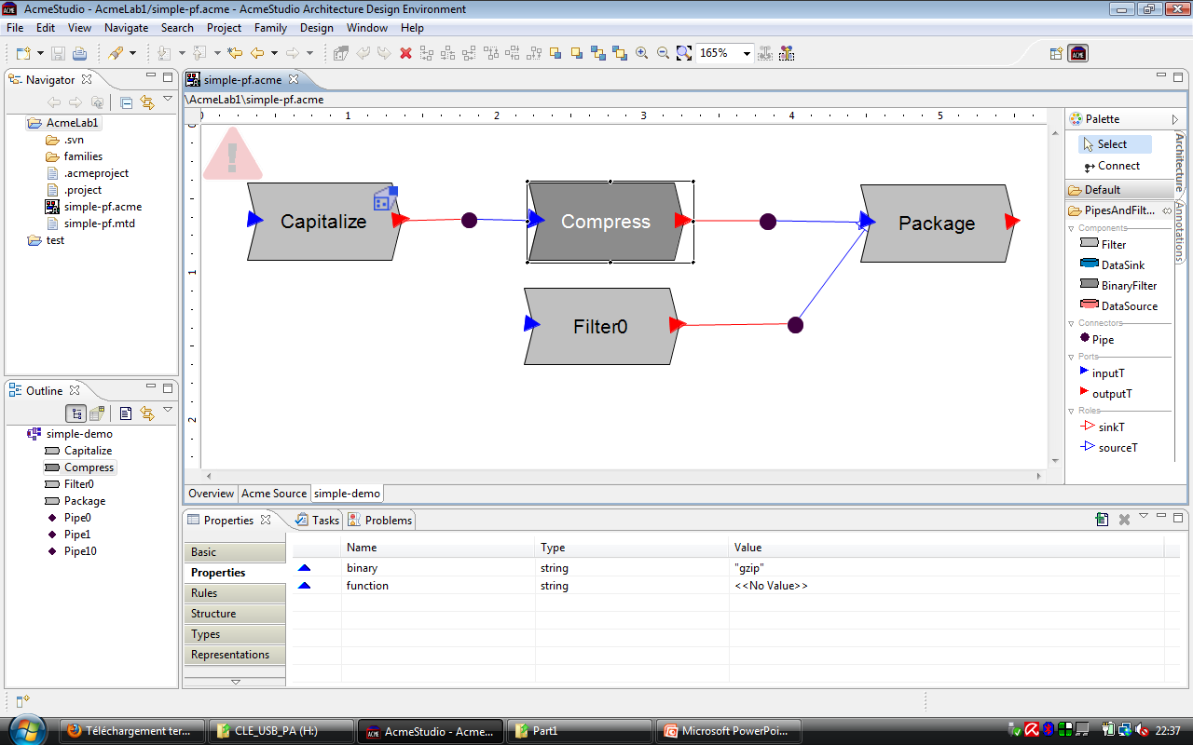
3. ACMESTUDIO (cont.)
Why do we use ADLs?
ADL Choice
ACME Presentation
ATAM introduction

Slide 22
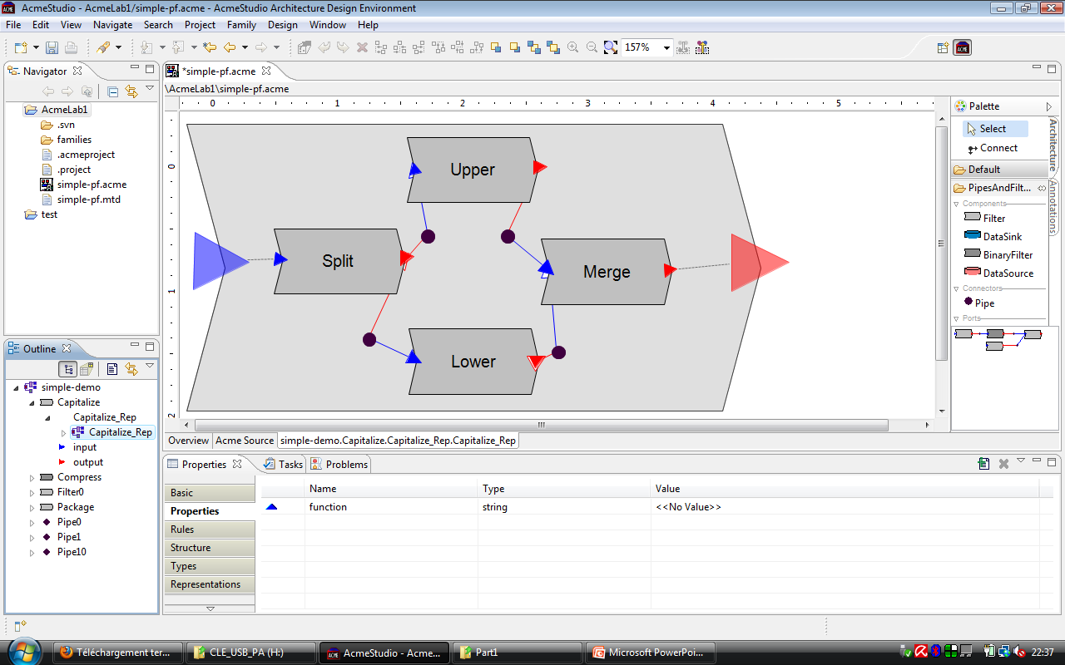
3. ACMESTUDIO (cont.)
Why do we use ADLs?
ADL Choice
ACME Presentation
ATAM introduction

Slide 23
4. ATAM
Why do we use ADLs?
ADLChoice
ACME Presentation
ATAM introduction
Architecture Tradeoff Analysis Method
Risk identification method to assess the consequences of architectural decisions in light of quality attribute requirements.
The ATAM can be done early in the software development life cycle.
It can be done relatively inexpensively and quickly (because it is assessing architectural design artifacts).
The ATAM will produce analyses commensurate with the level of detail of the architectural specification.

Slide 24
4. ATAM(cont.)
Why do we use ADLs?
ADLChoice
ACME Presentation
ATAM introduction
Three of the major goals of ATAM are to:
elicit and refine a precise statement of the architecture’s driving quality attribute requirements
elicit and refine a precise statement of the architectural design decisions
evaluate the architectural design decisions to determine if they satisfactorily address the quality requirements

Slide 25
4. ATAM(cont.)
Why do we use ADLs?
ADLChoice
ACME Presentation
ATAM introduction
The output of an ATAM is an out-brief presentation and/or a written report that includes the major findings of the evaluation.
These are typically
the architectural styles identified
a "utility tree" — a hierarchic model of the driving architectural requirements
the tradeoff points
the sensitivity points
a set of identified risks
a set of identified non-risks

Slide 26
4. Atam assessment steps
Why do we use ADLs?
ADLChoice
ACME Presentation
ATAM introduction
1
2
Present FDIR business case
3
Present FDIR architecture made through ACME
4
5
6
7
8
9
Identify FDIR architectural approaches made through ACME
Generate FDIR quality attribute utility tree
Analyze architectural FDIR approaches made through ACME
Brainstorm and prioritize scenarios of FDIR requirement
Analyze FDIR architectural approaches made through ACME
Present FDIR ATAM assessment results
Present the ATAM

Slide 27

ACME A powerful ADL
Thank you for attention !
Project 2
OP4
ADL presentation
Euro Team
Alauzet Pierre, Ahvenniemi Mikko,
Colin Julien, Starck Benoit
CS554 - Design for Software & Systems

Slide 28
references
David S. Wile, ACME: An Interchange Language for Architecture Representation
http://www.cs.cmu.edu/~acme/, ACME websites
http://en.wikipedia.org/wiki/Architecture_description_language, ADL wikipedia page
[KKC00] R. Kazman, M. Klein, P. Clements, ATAM: A Method for Architecture Evaluation, CMU/SEI-2000-TR-004, Software Engineering Institute, Carnegie Mellon University, 2000.

